Slide 1
Industrial Management IPE 4111
Marketing Management
Presented By
Nur Md. Alif ul Islam
Lecturer, Dept. of MPE, AUST

Slide 2
BACKGROUND
The term “marketing”, is derived from the word “market”, which refers to a group of sellers and buyers that cooperate to exchange goods and services. The modern concept of marketing evolved during and after the industrial revolution in the 19th and 20th centuries.

Slide 3
What is marketing ?
Marketing is the process of planning and executing the conception, pricing, promotion, and distribution of ideas, goods, services to create exchanges that satisfy individual and organizational goals.
- American Marketing Association

Slide 4
What is marketing ?
“Marketing is the management process that identifies, anticipates and satisfies customer requirements profitably”
- The Chartered Institute of Marketing

Slide 5
Functions/Objectives of Marketing
To give direction to the marketing division as a whole as well as to its various departments.
Satisfaction to the customers
Increase in demand
Provide better quality products to the customers
Create good will for the organization
Generate profitable sales volume
To set growth targets

Slide 6
Marketing Management
“Marketing Management is the analysis, planning, implementation and control of programs designed to create, build and maintain beneficial exchanges and relationships with target markets for the purpose of achieving organizational objectives.”

Slide 7
Functions of MM
Marketing Research
Sales forecasting
Advertising
Sales promotion
Selling
Handling of inquiries and orders from customers
Packaging
Servicing

Slide 8
Marketing Research
Marketing research may be defined as an organization wide approach which includes all research activities involved in marketing problems.
Market research provides an effective sales forecast.
Market research promotes soundness of marketing decision.

Slide 9
Objectives of marketing Research
Determines who and where the customer is; what is his needs and wants; what will he buy; where and how he will buy; and how much he will pay.
Tells the future of existing products
Measures sale trends and sales potential
Analyze distribution, economic trends and profitability.
Determine advertising effectiveness, customer reaction and dealer reaction
Studies market potential and market share
Conduct demand and price studies
Keeps a business in touch with its markets.
Explores new markets and helps developing new products
Safeguards the interests of the company against unforseen changes in the market.
Guides sales promotion efforts.
Analyze user characteristics, attitudes and opinion.

Slide 10
Scope of MR
Measurement of market potential
Determination of market characteristics
Market share analysis
Competitive product studies
New product acceptance
Product mix studies
Media research
Pricing studies
Plant and warehouse location studies
Packaging research
Distribution channel studies.

Slide 11
Market research procedure
Define the problem clearly
Develop a clear set of research objectives
Supervise or subcontract the task of collecting the data from existing consumers.
Extract meaningful information from the collected data.
Prepare a report presenting the major findings and recommendation coming from the study.

Slide 12
Techniques of Marketing Research
Desk research
Data is collected from the information published by the company or outside sources.
Desk research is done on:
Sales analysis
i.e past sales, fluctuations sales etc.
Correlation studies
i.e. number of new cars produced and number of car batteries sold.
Ratios
such as profit per dollar invested etc.

Slide 13
Techniques of Marketing Research
2. Postal Questionnaire
Carefully prepared questionnaire consisting of questions-short, specific and statistical or open minded.
3. Telephone interviews
4. Personal Interviews
5. Observational methods
Marketing research personnel silently observe others and collect the desired information
6. Statistical methods
Use of large pre-collected data and logically conclude the market investigations.
Histogram, check sheet, frequency polygon and the concept of mean, median and standard deviation are used.

Slide 14
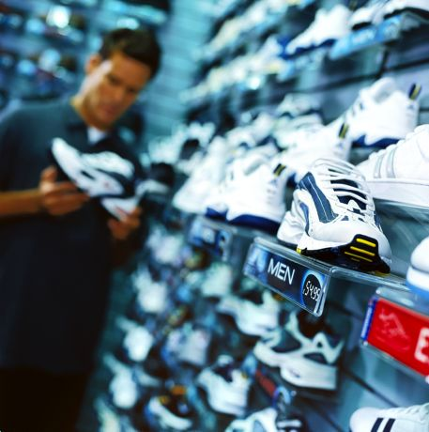
What is Marketed?
Goods
Services
Events & Experiences
Persons
Places & Properties
Organizations
Information
Ideas

Slide 15
What Is Marketed?
Goods: Physical goods constitute the bulk of most countries’ production and marketing efforts. Ex: refrigerators, televisions, machines.
Services: As economies advance, a growing proportion of their activities focuses on the production of services. Services include the work of airlines, hotels, car rental firms, barbers and beauticians, maintenance and repair people.
Events Marketers promote time-based events, such as major trade shows, artistic performances, and company anniversaries.
Experiences By orchestrating several services and goods, a firm can create, stage, and market experiences

Slide 16
Cont..
Persons Artists, musicians, CEOs, physicians, high-profile lawyers and financiers, and other professionals often get help from marketers
Places Cities, states, regions, and whole nations compete to attract tourists, residents, factories, and company headquarters
Properties Properties are intangible rights of ownership to either real property (real estate) or financial property (stocks and bonds).
Organizations Museums, performing arts organizations, corporations, and nonprofits all use marketing to boost their public images and compete for audiences and funds.

Slide 17
Cont..
Information: Information is essentially what books, schools, and universities produce, market, and distribute at a price to parents, students, and communities.
Ideas: Every market offering includes a basic idea. Charles Revson of Revlon once observed: “In the factory we make cosmetics; in the drugstore we sell hope.” Products and services are platforms for delivering some idea or benefit. Social marketers promote such ideas as “Friends Don’t Let Friends Drive Drunk” and “A Mind Is a Terrible Thing to Waste”

Slide 18
Who Markets?
Marketers And Prospects: A marketer is someone who seeks a response—attention, a purchase, a vote, a donation—from another party, called the prospect. If two parties are seeking to sell something to each other, we call them both marketers.
Marketers are skilled at stimulating demand for their products, but that’s a limited view of what they do. They also seek to influence the level, timing, and composition of demand to meet the organization’s objectives

Slide 19
Demand States
Negative
Nonexistent
Latent
Declining
Irregular
Full
Overfull
Unwholesome

Slide 20
Eight demand states are possible:
1. Negative demand—Consumers dislike the product and may even pay to avoid it.
2. Nonexistent demand—Consumers may be unaware of or uninterested in the product.
3. Latent demand—Consumers may share a strong need that cannot be satisfied by an existing product.
4. Declining demand—Consumers begin to buy the product less frequently or not at all.
5. Irregular demand—Consumer purchases vary on a seasonal, monthly, weekly, daily, or even hourly basis.
6. Full demand—Consumers are adequately buying all products put into the marketplace.
7. Overfull demand—More consumers would like to buy the product than can be satisfied.
8. Unwholesome demand—Consumers may be attracted to products that have undesirable social consequences.

Slide 21
Markets
Traditionally, a “market” was a physical place where buyers and sellers gathered to buy and sell goods. Economists describe a market as a collection of buyers and sellers who transact over a particular product or product class (such as the housing market or the grain market).

Slide 22
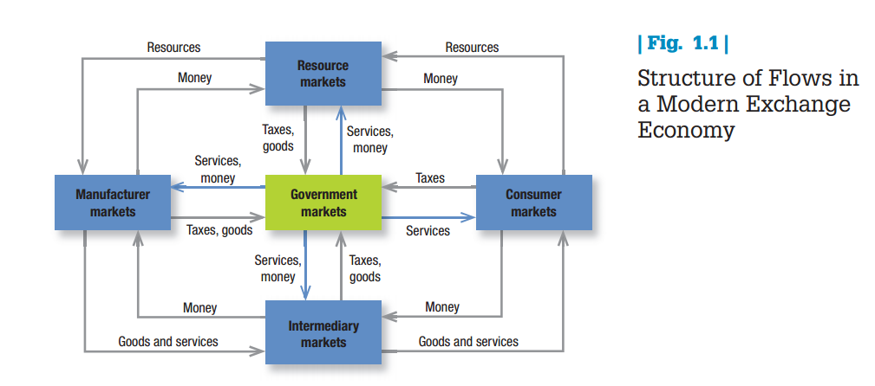
Five basic markets

Slide 23
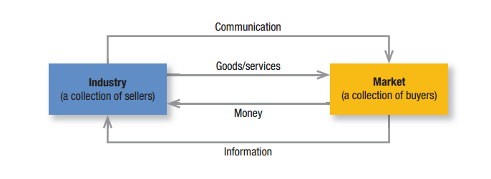
A Simple Marketing System

Slide 24
key customer markets
Consumer Markets Companies selling mass consumer goods and services such as juices, cosmetics, athletic shoes, and air travel establish a strong brand image by developing a superior product or service, ensuring its availability, and backing it with engaging communications and reliable performance.
Business Markets Companies selling business goods and services often face well-informed professional buyers skilled at evaluating competitive offerings. Advertising and Web sites can play a role, but the sales force, the price, and the seller’s reputation may play a greater one.

Slide 25
Cont..
Global Markets Companies in the global marketplace navigate cultural, language, legal, and political differences while deciding which countries to enter, how to enter each (as exporter, licenser, joint venture partner, contract manufacturer, or solo manufacturer), how to adapt product and service features to each country, how to set prices and how to communicate in different cultures.
Nonprofit and Governmental Markets Companies selling to nonprofit organizations with limited purchasing power such as churches, universities, charitable organizations, and government agencies need to price carefully. Much government purchasing requires bids; buyers often focus on practical solutions and favor the lowest bid

Slide 26
Core Marketing Concepts
Needs are the basic human requirements such as for air, food, water, clothing, and shelter. Humans also have strong needs for recreation, education, and entertainment
These needs become wants when directed to specific objects that might satisfy the need. A U.S. consumer needs food but may want a Chicago-style “deep-dish” pizza and a craft beer. A person in Afghanistan needs food but may want rice, lamb, and carrots. Our wants are shaped by our society
Demands are wants for specific products backed by an ability to pay. Many people want a Mercedes; only a few can buy one. Companies must measure not only how many people want their product, but also how many are willing and able to buy it

Slide 27
Five types of needs
1. Stated needs (The customer wants an inexpensive car.)
2. Real needs (The customer wants a car whose operating cost, not initial price, is low.)
3. Unstated needs (The customer expects good service from the dealer.)
4. Delight needs (The customer would like the dealer to include an onboard GPS system.)
5. Secret needs (The customer wants friends to see him or her as a savvy consumer.)

Slide 28
Target Markets, Positioning, And Segmentation
Not everyone likes the same cereal, restaurant, university, or movie. Marketers therefore identify distinct segments of buyers by identifying demographic, psychographic, and behavioral differences between them.
They then decide which segment(s) present the greatest opportunities. For each of these target markets, the firm develops a market offering that it positions in target buyers’ minds as delivering some key benefit(s).

Slide 29
Offerings And Brands
Companies address customer needs by putting forth a value proposition, a set of benefits that satisfy those needs. The intangible value proposition is made physical by an offering, which can be a combination of products, services, information, and experiences
A brand name such as Apple carries many different kinds of associations in people’s minds that make up its image: creative, innovative, easy-to-use, fun, cool, iPod, iPhone, and iPad to name just a few. All companies strive to build a brand image with as many strong, favorable, and unique brand associations as possible.

Slide 30
Marketing Channels
To reach a target market, the marketer uses three kinds of marketing channels
Communication channels
deliver and receive messages from target buyers and include newspapers, magazines, radio, television, mail, telephone, smart phone, billboards, posters, fliers, CDs, audiotapes, and the Internet
Distribution channels help display, sell, or deliver the physical product or service(s) to the buyer or user
To carry out transactions with potential buyers, the marketer also uses service channels that include warehouses, transportation companies, banks, and insurance companies

Slide 31
Value And Satisfaction
Value, a central marketing concept, is primarily a combination of quality, service and price (qsp)
Value perceptions increase with quality and service but decrease with price
Satisfaction reflects a person’s judgment of a product’s perceived performance in relationship to expectations.

Slide 32
Supply Chain
The supply chain is a channel stretching from raw materials to components to finished products carried to final buyers
A supply chain consists of all parties involved, directly or indirectly, in fulfilling a customer request. The supply chain includes not only the manufacturer and suppliers, but also transporters, warehouses, retailers, and even customers themselves.

Slide 33
The New Marketing Realities
Technology: The pace of change and the scale of technological achievement can be staggering. The number of mobile phones in India recently exceeded 500 million, Facebook’s monthly users passed 1 billion, and more than half of African urban residents were able to access the Internet monthly.
With the rapid rise of e-commerce, the mobile Internet, and Web penetration in emerging markets, the Boston Consulting Group believes brand marketers must enhance their “digital balance sheet”.

Slide 34
Globalization
The world has become a smaller place. New transportation, shipping, and communication technologies have made it easier for us to know the rest of the world, to travel, to buy and sell anywhere
Globalization has made countries increasingly multicultural. U.S. minorities have much economic clout, and their buying power is growing faster than that of the general population

Slide 35
Social Responsibility
Poverty, pollution, water shortages, climate change, wars, and wealth concentration demand our attention. The private sector is taking some responsibility for improving living conditions, and firms all over the world have elevated the role of corporate social responsibility

Slide 36
Sales forecasting
Forecasting is the art of anticipating what buyers are likely to do under a given set of conditions.
Should be accurate because whole production and stock holding plans are based on them.
Sales forecasting factors
Government action
Economic trends
Competition
Change in technology and markets
Internal factors such as capacity, available resources etc.

Slide 37
Marketing Mix
It is the combination of competitive efforts or the particular group of variables offered to the market at a particular point of time. These variables are:
Product ( variety, quality, brand name, packaging etc)
Price ( basic price, discounts, credit terms etc)
Promotion( Advertising, personal selling, etc)
Distribution or place ( channels, sales forces, coverage, transport etc)

Slide 38
Advertising
Advertising may be defined as commercial messages to the public, designed to inform potential and established consumers and to encourage sales for the advertiser.
Advertising arouse public interest, fosters a buying attitude and raises consumer demand for the products of a company.

Slide 39
Objectives of advertising
Introduce existing and new company products to the public
Enhance potential buyer’s responses to the company and its offerings
Tell that a product which the customers want exists and from where it can be procured and at what price.
Make a product stand against its competitor product.
Creates a confidence in the minds of buyers regarding quality of those products.
Build up reputation for the company goods and services
Find new users
Increase profit.

Slide 40
Functions of advertising department
Preparation and control of advertising budget
Determination of the appropriate allocation of funds to be spent on advertising and sales promotion activities.
Supervising advertising and marketing research
Keeping touch with representatives
Cooperation with sales and other departments
Distribution of advertising material

Slide 41
Advertising media
Newspaper
Magazines
Radio
Television
Direct mail
Public transportation
Outdoor billboards
Exhibits and displays
Slides in cinemas
Distributing gifts bearing the name of company and its products.

Slide 42
Disadvantages of advertising
1. It Is a Costly Function
2. Misleading Claims About Products( 100% pure…)
3. Encouragement of Monopoly
Advertisement restricts competition among products. Big industrialists and manufacturers can use advertising to increase their monopolistic control over the market against the public interest. Advertising increases awareness about a few products but causes all other options to be overlooked.
4. High Prices of Products and Services
5. Small Businesses Have Restricted Access
6. Misdirection of Purchasing Power
Advertising high-priced luxury goods influences the purchasing power of consumers. This results in some people using unscrupulous means to increase their income for the purpose of getting things they perceive as necessities of life. Thus, unnecessary advertising creates societal corruption.

Slide 43
Cont…
7. Dangerous Distractions
Billboards, posters, and electronic moving pictures are placed around important intersections, which distract drivers and pedestrians. Glaring neon lights and signs are hazards and have potentially deadly consequences.
8. Unfulfilled Desires
Another disadvantage of advertising is that it influences the mind of the public and creates a desire and taste for new products that are not necessities and that most cannot afford. Thus, advertising fosters unrequited desire and causes unhappiness.
9. Promotion of Social Evils
Some businesses support immoral and sensational programs as well as crime stories on television and radio, thus choosing them as vehicles for advertising. These programs corrupt the values of young people and promote social evils.
10. Confusion About Characteristics of Products
Many similar products are advertised on the market, but producers put great emphasis on minor differences in the formula, technique, or make of advertised goods. For example, there are many brands of shaving creams which perform the same function but are advertised as dramatically different products.

Slide 44
Sales Promotion
It can be defined as all the activities that go into the development of sales or those that are intended to raise the demand level for a product very quickly.
Advertising, personal selling or publicity.

Slide 45
Sales promotion Methods
Consumer promotion- persuading consumers to buy; these includes samples, prices-off, contests and competitions. ( i.e. the winner customer will have a trip to Europe, etc)
Trade Promotion- incentives to distributors and others to hold stocks of company product; includes discounts, buying allowance, one or two free units per bulk container. Dealer competitions.
Sales force promotions- bonuses, contests, sales rallies etc. for the salesmen.
Good public relations- develop goodwill and increase sales.
Good customer relations- speedy handling of complaints, assistance in emergencies, abiding by announced policies etc.

Slide 46
Sales promotion Methods
Display- at the points of sale, using posters, banners, placards and leaflets etc.
Product exhibitions, demonstrations and conferences.
Holding competition and awarding prizes to winners.
Latest product styling and appealing product packaging.

Slide 47
Functions of sales Promotion Department
Product packaging detailing
Service to salesmen
Service to dealers
Making displays
Helping dealer in demonstrations, door to door canvassing etc.
Publicity.

Slide 48
Difference between advertisement and publicity
Advertising | Publicity
The activity of generating advertisements of products and services to commercialize them is known as Advertising. | The activity of providing information about an entity, i.e. a product, an individual or a company to make it popular is known as Publicity.
It is what the company says about its product. | It is what others say about the product.
Very expensive marketing tool. | Free of cost.
Done by Company and its representative | Done by Third Party
It is under the control of the company | It is not under the control of the company
It conveys positive message. | It conveys positive or negative message.

Slide 49
Product Packaging
Packaging is the art, science and technology of preparing goods or products for transport and sale.
Packaging is the means of ensuring safe delivery of the product to the ultimate consumer in sound condition at minimum overall cost.

Slide 50
Objectives of packaging
To protect the products against damage in transit.
To protect the contents from being spoiled (tinned food products).
A package good is convenient to handle or transport.
A package good is safe to store
An attractive package possesses considerable sales appeal and thus promotes sales of the product

Slide 51
Requirements
Speak about the product
Catch the attention of consumers
Look clean and sanitary
Prevent spoilage of product
Be of convenient size and shape to carry
Be easy to open

Slide 52
Factors considering at packaging
Nature of product
Liquid, solid, powder, gas, corrosive, inflammable, volatile, explosive etc.
Properties of the product
Size, shape, weight, value. Transportation hazard.

Slide 53
Pricing
Price of the product is the means whereby manufacturers obtain a fair return for their labors and increase their wealth and purchasing power in return for supplying the products.
Pricing is the process whereby a business sets the price at which it will sell its products and services

Slide 54
Factors affecting price fixation
Fair trade laws.
Nationally advertised prices and government restricted prices of different products.
Desired customer clientele
Company monopoly
Manufacturer’s suggested prices
Type of merchandises
Nature of sales
Price lining
Whether large volume with low unit profit or relatively small volume with high unit profit is desired.
Suitable channels of distribution
Sales promotional strategy

Slide 55
Sales Management
Sales management is the term applied to the process of distributing goods from the producer to the ultimate user. It consists of selling, storing, transporting and handling and financing or risk-taking.

Slide 56
Functions of sales department
Analyzing market thoroughly
Studying consumer’s psychology and demand.
Studying the market fluctuations.
Assisting in the preparation of marketing plan
Preparing the sales budgets from the marketing plan.
Developing systems for sales reporting and statistical analysis.
Determining sales staff requirements and handling the requirement, training and compensation of sales staff.
Striving continuously to lower selling costs, to expand sales and to improve the product for its wider acceptability.

Slide 57
Marketing vs Sales
Marketing | Sales
Marketing is the systematic planning, implementation and control of business activities to bring together buyers and sellers. | A sale is a transaction between two parties where the buyer receives goods (tangible or intangible), services and/or assets in exchange for money.
Marketing is one to many. | Sales is about one to one.
Marketing tells the stories (company, product, etc.) to many people. | Sales is where our business becomes real for the client. It is where the stories and brand come to life.
Marketing looks after the brand’s reputation. | Sales develops relationships. It’s relationship-driven.
Marketing analyses the big data. Marketing brings you the average result not the specifics. | Sales deals with the ambiguities and the details of each person. It cannot be averaged.
Longer term horizon. | Short term horizon.
Marketing shows how to reach to the Customers | Selling is the ultimate result of marketing.

